Slide 1
Dimensionality Reduction
WKSP 320 Module 1, Lesson 1
Notes:
Welcome to this lecture on Dimensionality Reduction.
Even though we have more and more computing power, you’ll find that using very large datasets most of the time is impractical.
Often, it’s not necessary. There is a lot of redundant data that is collected, so it’s wise to remove that. This will speedup your model and also make it more explainable.

Slide 2
Step By Step
Correlation (Heatmap)
Random Forest Variable Importance
Principal Component Analysis
Notes:
So there’s many different ways to do this, from simple to very complex.
The simplest way is to start with correlation. This is a good rule of thumb when initially exploring your data. Find out which variables are very similar to each other. Often, you’ll find that if you have 2 or more highly correlated variables, you can keep just one and see minimal loss in model performance.
Next we’ll go over an existing algorithm Random Forest offers a built-in variable importance metric, and finally, we’ll use a more advanced method called Principal Component Analysis or PCA.

Slide 3
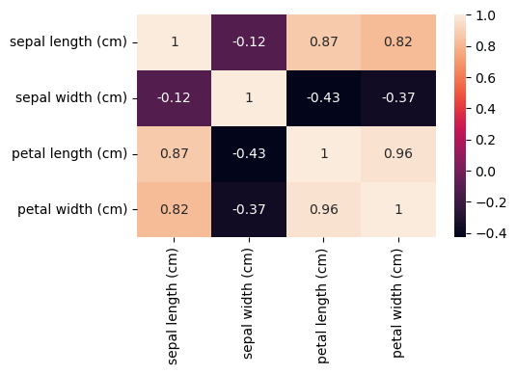
Correlated Variables
Notes:
So often when we’re exploring our data, we’ll use a heatmap to identify correlated variables. If two or more are highly correlated to each other, you can consider removing one or more and focus on the signal in the remaining variable.
This is a heatmap of the variables in the Iris dataset. You can see that petal length is correlated with petal width with a 0.96 correlation, which is very high.
Heatmaps are really only good for a small number of variables. If you have more than 10, you get a 10x10 matrix and you can easily be overwhelmed looking at that. For a larger number of variables, you can first find a variable that is important to the model and then do pair-wise correlation to the rest of the variables and do a bar-plot. Or you could try to correlate the variables to your class label, after converting the class label to a numeric value.
One other drawback of using correlation and heat maps is that it will tell you which variables are correlated. But it doesn’t tell you if those are useful for the model. For example, you could have a set of highly correlated variables that don’t have any prediction power to predict the correct class.

Slide 4
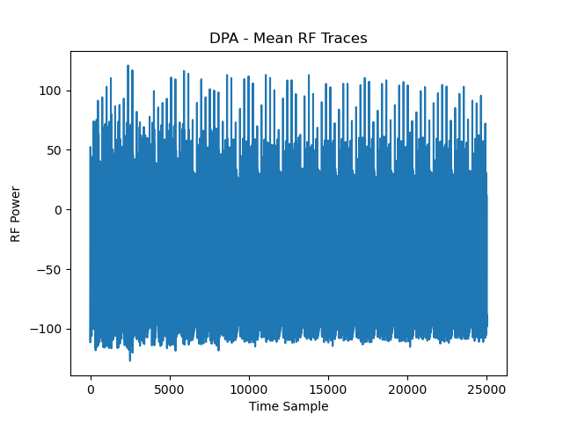

Differential Power Attack
Running AES
Notes:
For the next method, let me first describe the dataset we’ll be using. I am taking a dataset from research I’ve done in the past. Here we used an RF probe to capture the power consumed by a chip while it was encrypting data with the AES algorithm.
On the right is an average plot of the waveform. You’ll see that it’s very repetitive – that’s because the AES algorithm processes the data in multiple stages or “rounds” and each round has exactly the same instructions.
The data we want to process is only in one of these rounds, but we don’t know where. So there are 25000 time samples and most of these are not useful for our machine learning model.

Slide 5
Hamming Weight
Less Power
Byte Value | Hamming Weight
0000 0000 | 0
0000 0001 | 1
0000 0011 | 2
0000 0111 | 3
0000 1111 | 4
0001 1111 | 5
0011 1111 | 6
0111 1111 | 7
1111 1111 | 8
More Power
Notes:
The target in DPA is the Hamming Weight of a byte of data. The Hamming weight is the number of bits that are high in the byte. This table shows examples.
The theory, which has been proven, is that there is a direct correlation between the Hamming Weight and the power used by the chip to store that data. So more high bits means more power used by the chip. So using this relationship, we can estimate the Hamming Weight of the chip based on the power being used at that time.

Slide 6
Notes:
Again, this is the graph of the waveform. 25000 variables, most of them are not of interest in estimating the hamming weight.
Most of the time, this many variables are way too many to be useful. In this case most were highly correlated, which means redundancy, or not useful to the machine learning model.

Slide 7
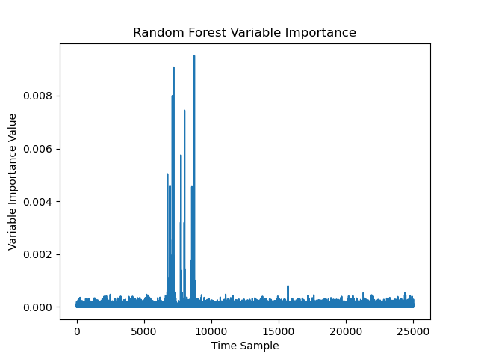
Notes:
This is a plot of the variable importance after growing a Random Forest classifier on the full dataset. It shows that of the 25000 time samples, very few are showing to be related to the target variable we are trying to find. It turns out that the processor is only using the particular byte of data we’re interested in during these time samples.
It would be very easy with this graph to down-select to only those time samples that are greater than a threshold. With this method, we can reduce down the 25000 time samples in the original dataset to something close to 60. This not only reduces processing time, but can sometimes improve accuracy as you are less likely to incorrectly use a variable that does not have any prediction power.

Slide 8
Linear Algebra Methods
Principal Component Analysis
Latent Factor Analysis
Less constrained PCA
Linear Discriminant Analysis
Class-Aware
Notes:
There are many other methods out there that are based on using linear algebra. We will discuss PCA in the next slides. There are also methods such as Latent Factor Analysis and Linear Discriminant Analysis that we will not cover here but can be useful as well.
For PCA, you have the constraint that the covariance matrix needs to be symmetric. Most of the time this is fine. But Latent Factor Analysis relaxes this constraint.
Also PCA does not depend on the target classes. So sometimes you’ll get a PCA transformation that does not increase the separation between classes. So you’re not guaranteed to get a better result with PCA. Linear Discriminant Analysis does take the class labels into account and may offer better results if PCA does not help.

